Slide 1




NEXT GEN EMPLOYABILITY PROGRAM
Creating a future-ready workforce
Team Members
College Name
Student Name : HEMAVATHI H
Student ID : au110621104012
INDIRA INSTITUTE OF ENGINEERING AND TECHNOLOGY

Slide 2

CAPSTONE PROJECT SHOWCASE
Project Title
MUSIC WEB APPLICATION USING DJANGO FRAMEWORK
Abstract | Problem Statement | Project Overview | Screen Short | Technology Used | Modelling & Results | Conclusion

Slide 3
Abstract
The Music Web Application using Django Framework is a sophisticated platform designed to provide users with a seamless and immersive music listening experience.
Key Features:
User Authentication and Authorization: The application allows users to create accounts, sign in securely, and manage their profiles. It implements robust authentication and authorization mechanisms to ensure data security and privacy.
Music Library Management: Users can upload, organize, and manage their music library within the application. Search and Discovery: The application offers powerful search and discovery functionalities, allowing users to easily find their favorite songs, albums, or artists.
Streaming and Playback: Users can stream and play music directly within the application. The built-in media player supports playback controls, playlists, shuffle, repeat, and volume adjustments, providing a seamless listening experience.
Social Interaction: The application fosters social interaction among users by enabling features such as following other users, sharing playlists, and commenting on songs.
Personalization and Recommendations: The application leverages machine learning algorithms to provide personalized music recommendations based on user preferences, listening habits, and music metadata. It learns from user interactions and adapts recommendations over time.
Source :

Slide 4
Problem Statement
The Music Web Application using Django Framework aims to address the need for a comprehensive and user-friendly platform for managing and enjoying music content online. In today's digital age, music lovers seek convenient ways to access and organize their favorite songs, discover new artists, and engage with a community of fellow music enthusiasts. However, existing music streaming platforms may lack certain features or may not fully meet the preferences and requirements of users.
The goal of this project is to develop a robust web application that offers a wide range of features and functionalities to enhance the music listening experience. The application should provide users with the ability to upload, organize, and manage their music libraries seamlessly. It should offer advanced search and discovery capabilities, allowing users to explore new music based on their preferences and listening habits.
Source :

Slide 5
Project Overview
User-Friendly Interface: The application will boast an intuitive and visually appealing user interface, ensuring ease of navigation and accessibility for users of all skill levels.
Extensive Music Library: Users will have access to a vast and diverse collection of songs, albums, and playlists spanning multiple genres, artists, and languages, providing a comprehensive music discovery experience.
Personalized Recommendations: Leveraging machine learning algorithms, the application will analyze user preferences and listening habits to deliver personalized music recommendations, enhancing the user's music discovery journey.
Social Integration: The application will facilitate social interaction among users, allowing them to connect with friends, share their favorite music content, and discover new artists through social sharing and collaboration features.
Seamless Streaming Experience: Users will enjoy seamless audio streaming with high-quality playback and customizable features such as shuffle, repeat, and playlist management, ensuring a satisfying and immersive listening experience.
Source :

Slide 6
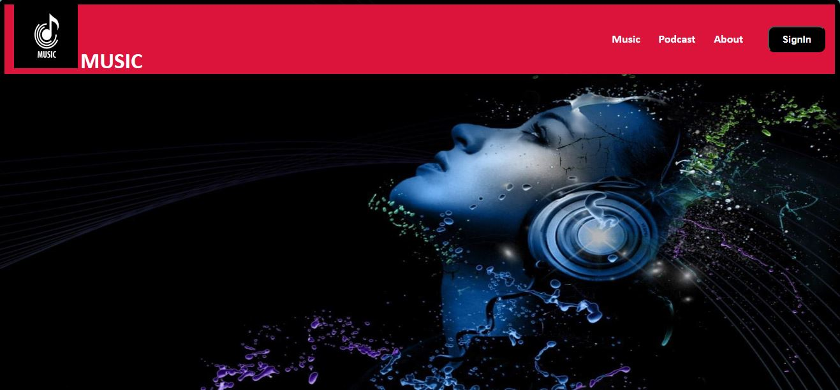
Screen Short
.
Source :

Slide 7
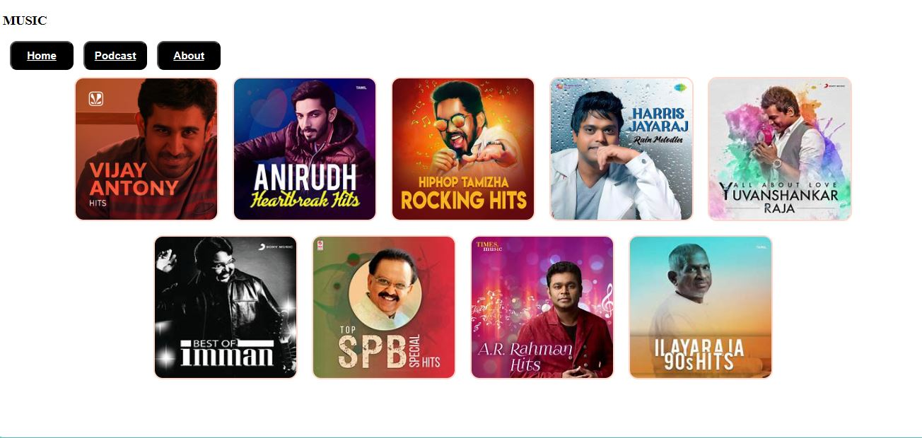
Source :

Slide 8
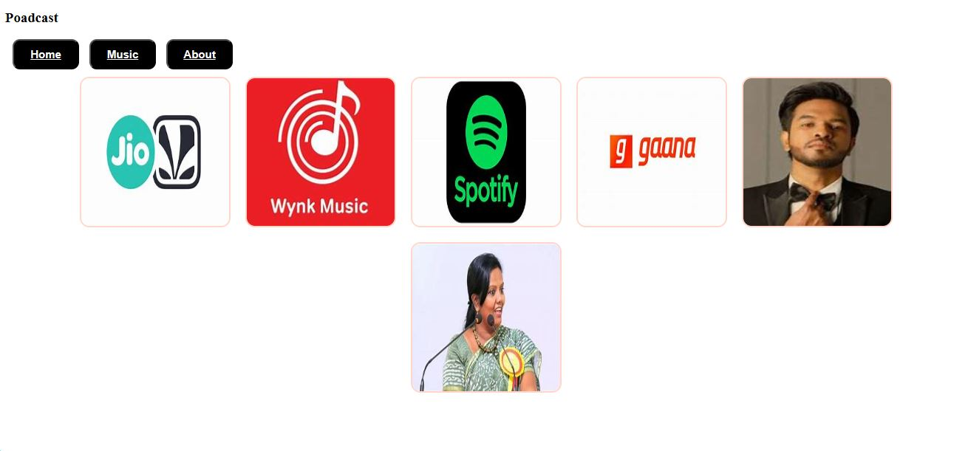

Slide 9
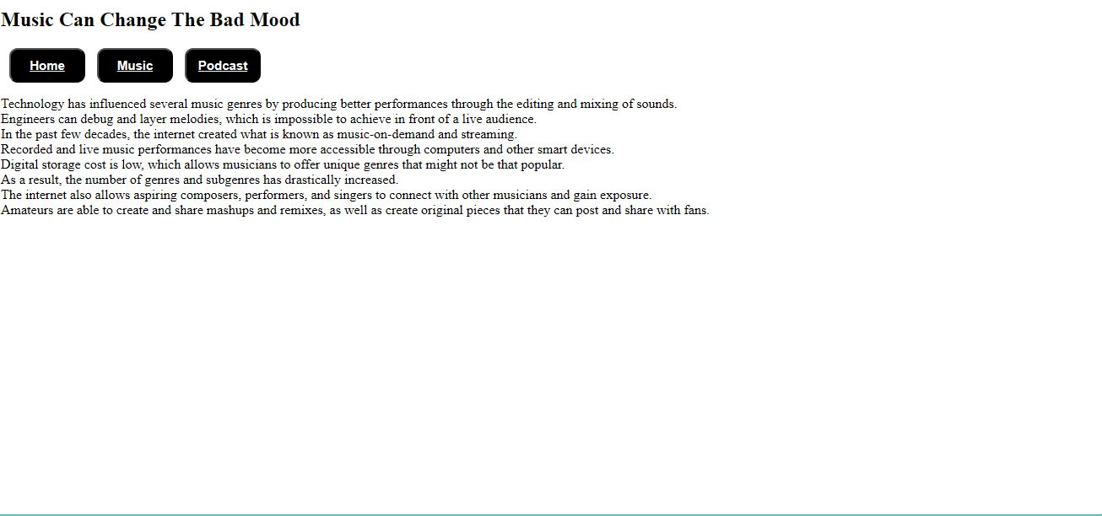

Slide 10
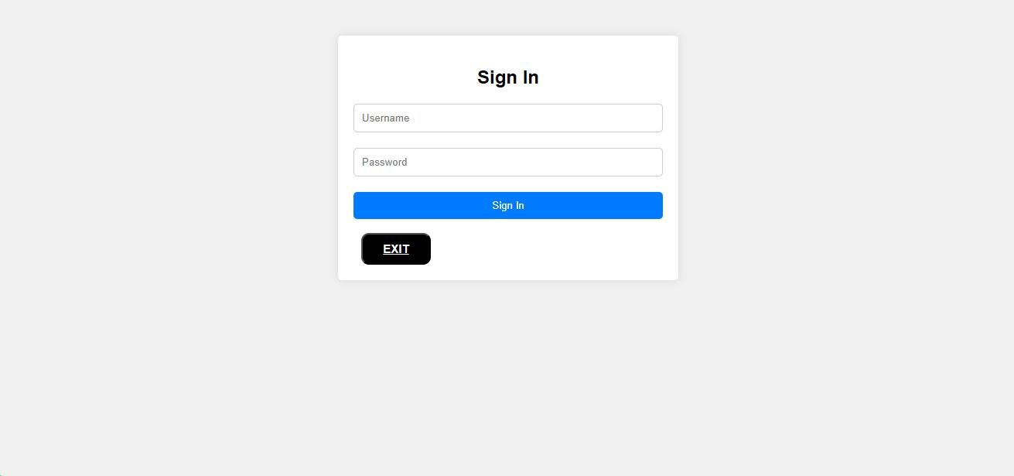

Slide 11


Technology Used
Front-end
Back-end
Source :

Slide 12
Future Enhancements:
For future enhancements, the Music Web Application using Django Framework can explore several avenues to further enrich the user experience and expand its capabilities. One key area for improvement is the recommendation engine, where advancements in machine learning algorithms can be leveraged to provide even more accurate and personalized music suggestions. Additionally, the application can focus on enhancing social features by introducing forums, fan clubs, and live chat rooms to foster a sense of community among users. Integrating with external music APIs would allow for a broader selection of content, enriching the music library and catering to diverse tastes. Personalized user profiles could be introduced, enabling users to showcase their preferences and interact with the community in more meaningful ways. Advanced analytics tools can provide valuable insights into user behavior and engagement metrics, informing future development decisions. Furthermore, the application can explore virtual concert streaming, AR experiences, and integration with smart devices to offer innovative and immersive music experiences. Finally, maintaining a continuous feedback loop with users and adopting agile development methodologies will ensure that future enhancements align closely with user needs and preferences, driving ongoing improvement and innovation in the platform.

Slide 13
Conclusion
In summary, the Music Web Application using Django Framework offers a user-friendly platform for music discovery and enjoyment. With its vast music library, personalized recommendations, and social features, it provides an immersive music experience. Future enhancements such as advanced analytics and virtual events promise to further enrich the platform. By prioritizing user feedback and continuous innovation, the application aims to remain a leading destination for music enthusiasts worldwide.
Source :

Slide 14
Thank You!
Notes:
Thank You !!

